Slide 1


Product Catalog
Capabilities
Gregor Baues

Slide 2
Core Capabilities - Sales & Servicing Channels
Work-in-progress
Indirect Sales channels
Direct Online/Self Service channels
Direct Offline/Staff Assisted channels
Fulfillment channels
(including delivery provider channels?)
- to be detailed/refined -
Channel Management
Interaction
Management
Indirect Booking
Channel
Management
Interaction
Management
Online
Booking
Channel Management
Interaction
Management
Offline Booking
CORE CAPABILITIES
CRM
Attracting Customers
Core booking (and rebooking) capabilities
Fulfillment (to be detailed/refined)
Corporate
Contracts
Customer
Identification
Profiling
(& targeting?)
Offer Management
Order (Management)
Customer services?
R
Inspire &
Recommendation
E2E Journey Management
Rebooking
R
R
Search & Shopping
Offer
Creation
Order
Creation
(Mixed)
Payment
R
R
Compensation
Individual
Loyalty
Customer Data
Management
R
Travel Doc &
Clearance
Case
Management
Campaign
Management
E-mail marketing?
Offer Display Optimization?
R
R
S
R
(Dynamic?)
Packaging?
Order
Change
Refund
S
Product
Delivery
Ratings &
Feedback
Product Status
Notification
Product Management
Offer Strat
S
Offer
Personalization?
S
R
S
Bundling
Order Status
Notification
Settlement
Orchestration
S
Disruption Handling
Accounting
Baggage
Handling
Retailer-Supplier Agreements
R
S
S
Multi-Modal
Itinerary?
(Static) Pricing
(of products & packages)
Distribution
Strategy
Inventory
(Dynamic)
Offer Pricing
S
S
S
Order
Integrity
Settlement
Passenger Handling?
Case
Handling
(Flight &) Ground
Operations?
Product
Development?
Product Catalogue
(incl. packages)
Calculation
Fare filing?
Counters
Offer
Persistence
Manage RES back-end
processes & systems?
Fulfillment is colored green because there is a difference in abstraction level//granularity between Commercial (Sales) vs. Fulfillment capabilities
S
S
Availability
Network
Definition
S
Delivery Provider Management?
Inventory
Management
(Commercial)
Flight Schedule
Support capabilities
Analytics & Reporting
R
= Retailer-role only (AF or KL)
~ “Offer Responsible Airline”
or “Marketing Carrier”
S
Supplier-role only (AF or KL or 3rd parties)
~ “Participating Offer Airline”
or “Operating carrier”
Capabilities without R or S bullet apply to both retailer and supplier. Specifics of retailer and supplier roles will be detailed for each capability (in capabilities overview).
6
= reference to chapters with guidelines in this PPT
Notes:
Processed changes:
Retailer-Supplier split on a lower level (within the capabilities) as AFKL needs to perform both roles.
Merge package catalog with product catalog capability.
Merge Package pricing rules with Product (& package) Pricing capability
Rename pricing in offer to (“Dynamic/Offer pricing”)
Merge Package Offer with Product Offer.Add ‘packaging’ as a sub capability of create offer
Retailer-Supplier (partner) management is merged with retailer-supplier agreements capability
Open questions/actions:
Do we need an “offer display optimization” capability (related to Seller actor role?)
Do we need a customer support capability (in fulfillment)?
Resolve unbalance on the abstraction level / granularity of Sales vs. Fulfillment capabilities E.g. Offer Creation vs. Disruption Handling.
Clarify role of actors i.r.t. capabilities, complete descriptions of capabilities.

Slide 3
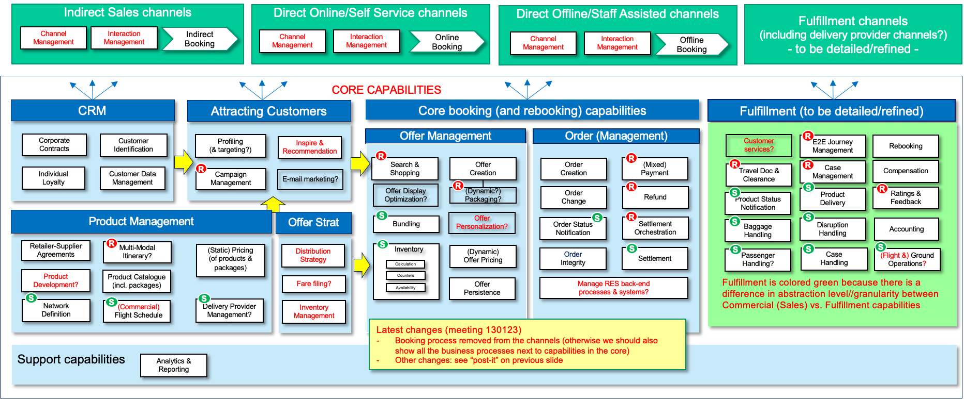
- Static pricing would be a property of a product changeable if needed
Third party management
-Supplier
Delivery providers
Product Portfolio
Product User / Customer experience related ( Product Meatadata ? )
Product Information Management
Retailer-Supplier Agreements
R
Multi-Modal
Itinerary?
(Static) Pricing
(of products & packages)
Product
Development?
Product Catalogue
(incl. packages)
The Product Catalog supports the Product management capabilities.
Offer strategy will impact the product definitions in the catalog
(This needs to be reviewed as we go on with the capability map of the catalog ) It doesn’t seem to be complete
IATA working group agrees that the network is here not so much the schedule )
S
S
S
Network
Definition
(Commercial)
Flight Schedule
Delivery Provider Management?

Slide 4


Product Catalog - CONTEXT
IDEATE / SEARCH / Order
Capture / ENGAGE & Retain / CONVERT
Any Channel
Offers send back
with all relevant
product Information
Request for Information
Request for an Offer
Request
Accepted Offer
Send to Order
Product Information
Is returned via the channel to the customer
Offer Engine (pricing)
Order Engine
PIM
Inventory
Personalization
PIM : Product Information management

Slide 5
Product Catalog
PRINCIPLES & capabilities (in no particular order)
The product catalog has no prices except for legal requirements (e.g. public prices in France).
The product catalog does not calculate the final offer (composition of products & services) nor the price.
The product catalog and its content shall not limit and/or constrain operational processes.
The product catalog does not contain any inventory information ( instances of sellable products e.g. instances taken from the schedules ).
The product catalog allows controlling exposure of its content through filters ( such as agreements )
Future of fares? Base price? MSRP - MANUF suggested retail price t
Traditional Retail PIM systems contain stock management as a feature but this doesn’t apply to us. Availability shall provide from existing processes. Box item stock levels if needed from existing warehouse/logistics systems

Slide 6
Product Catalog
PRINCIPLES & capabilities (in no particular order)
The product definition and description in the catalog must be extensible & configurable. ( → req an extensible ontology )
The product catalog must provide all product information required for the key offer/order / fulfillment processes
The product catalog must allow to manage B2B, B2T contracts such as e.g. SRISA for the interline case or any other Retailer / Seller / Supplier ( e.g. OTAs ) agreements
New Products get added by configuration and propagate across downstream systems
This information is not necessarily visible from the outside but may be according to context e.g. JV ) In general the catalog has to support differentiated exposure of properties according to the context of usage.
This open’s up also the question of corporate customers and the level of information we provide to them B2B ‘customers’

Slide 7
Product Catalog
PRINCIPLES & capabilities
Principle PC01 | The Product Catalog contains the master product information for internal and third-party consumption
Rationale | Sharing product information is the core function/capability of the catalog. The catalog is the single source of truth about available products but not the stock
Implication | This required the development of a meta-model structure for product descriptions allowing all parties to understand the elements transmitted in terms of product information (independent from any technical implementation. Implementation choices can be made internally but need to b standardized for exchange with third parties
Standardization Relevant | Yes. Semantic and Syntax need to be defined in particular for exchange with third parties.

Slide 8
Product Catalog
PRINCIPLES & capabilities (in no particular order)
Principle PC02 | The product catalog has no prices except for compliancy requirements
Rationale | The product catalog contains static information about the offered services and doesn’t contain all relevant information ( e.g. stock , demand, personalization, …. ) allowing to make an offer. The offer, i.e. a priced service offering, is generated by a different function
Implication | The most important implication is that there will be two types of requests from external parties Requesting Information about the services (optional) Requesting (an) offer(s) for services (mandatory) It shall be upon each partner to decide if product information is made available without actually requesting an offer and only the mandatory product information related to the offer is provided. Compliance requirements are for example the availability/publication of public prices in France.
Standardization Relevant | No. Prices will not be offered by the catalog so there is no need to standardize in the product information structure ( for exchange with third parties ) on the notion of prices. This will be required for the offer part.
Notes:
This may actually be part of the optional elements which can be requested. As the prices e.g; in the French case are public we need a means to communicate them. So if available then communicated ?
That needs clarification.

Slide 9
Product Catalog
PRINCIPLES & capabilities (in no particular order)
Principle PC03 | The product catalog does not calculate the final offer (composition of products & services) nor the price.
Rationale | The product catalog contains atomic or bundled services ( in which case the bundle is to be considered as atomic i.e. can not be decomposed ). The catalog doesn’t make any assumption on the possible aggregation of services & bundling into an offer. This will be done a by a different function according to the applicable strategies.
Implication | The exposure of the catalog to third parties will not provide any offer but only information on the atomic products and even this may not be reqd to be exposed shall any participant only elicit to publish offers.
Standardization Relevant | No.
Notes:
Do we need a s ort of discovery service ? Who does sell what ? …. IETF ?

Slide 10
Product Catalog
PRINCIPLES & capabilities (in no particular order)
Principle PC04 | The product catalog and its content shall not limit and/or constrain operational processes.
Rationale
Implication | In particular, this means that the exact time/dates schedule is not part of the catalog as they may vary heavily accordingly to operational conditions. The original transport service from point A to B will not disappear as a product but all flights from A to B on a given date may all be canceled e.g. because of weather conditions. i.e. the available ‘stock’ has changed but not the service itself.
Standardization Relevant | No.
Notes:
Do we need a s ort of discovery service ? Who does sell what ? …. IETF ?

Slide 11
Product Catalog
PRINCIPLES & capabilities (in no particular order)
Principle PC05 | The product catalog does not contain any inventory
Rationale | instances of sellable products e.g. instances taken from the schedules …
Implication
Standardization Relevant | No. Anyone can be free to choose to mix/integrate stock management / inventory with the catalog itself. This shall have no impact on the exposed Product Catalog / Offer Creation interfaces.

Slide 12
Product Catalog
PRINCIPLES & capabilities (in no particular order)
Principle PC06 | The product catalog content exposure is contextualized
Rationale | As a functional component, we only have one single product catalog as a master for all the product definitions. Nevertheless, the catalog's content, i.e. products and their properties, is not visible in the same way to all parties potentially interacting with it. Internal stakeholders, the general public, and partners with specific types/contents of contracts (SRSIA e.g. ) all have different requirements/needs/rights/obligations. The content provided by the catalog shall be available wrt. To the context in which the information was requested. This allows creating the differentiation esp. between Airline Profile ( aka Seller Catalog ), Airline and Supplier Catalog.
Implication | More on the technical side on the criteria of the filters etc ... Product meta model req properties for scoping / managing exposure Requires a model for contacts based i-on the IATA contract definitions ?
Standardization Relevant | Yes. In order to facilitate the processing of contextualized information exchange the conditions/rules which apply to filter the content shall be standardized as well just like the product definitions themselves. This will greatly improve the efficiency of adding new partners / contracts to the system.

Slide 13
Product Catalog
PRINCIPLES & capabilities (in no particular order)
Principle PC07 | The product definition and description in the catalog must be extensible & configurable.
Rationale | This principle is required and a precondition to be able to add new products by configuration into the overall processing chain but as well for improving on product definitions adding not yet identified product characteristics etc.
Implication | This is only possible if there is a consistent meta-model available for product descriptions which itself is based on a meta-meta model (cf. Examples provided to make the point clearer)
Standardization Relevant | Yes. Even if the main intent is to make the best use of the product catalog for internal processing requirements there is some need to define how extensions will be managed and formalized esp if they are relevant in the information exchange between parties

Slide 14

Product INFORMATION MANAGEMENT
PRINCIPLES & capabilities (in no particular order)
Catalog
Exposing our products
Product
Creating & Handle Products
Third Party
Organize our relationships
Enable different types of exposure (Digital, NDC, Print, …) / Channels
Product Meta Taxonomy / Ontology (Add products by configuration)
Contract Taxonomy / Ontology (Add contracts by configuration)
Expose Products according to a given context ( search / customer / Retailer / interline request
CRUD
CRUD
Conditions
Supplier Performance
Dynamic & Static Product Configuration
( Bundles / Packages / Compatibility)
Delivery Provider Performance
Product Categorization / taxonomies : Hierarchies / Facets
Conditions
B2B / B2T integration
(capture supplier catalogs)
Product Settings / Integrity
Product Merge
Product / Condition Merge
Contract Taxonomy / Ontology (Add Contract by configuration)
B2B / B2T / B2C Identity
Product Compare ( Properties / Attributes / Conditions )
Integration of the products of suppliers available to us as a retailer
Supplier selection *
Leverage Content Management & existing DAM
The supplier is not necessarily the delivery provider ( sub-contracting etc )
Product LCM
Supplier/delivery Provider selection * : Where does that take place ( Offer Engine ? ) The product catalog provides all possibilities ( within the agreements ) to the Offer engine
Notes:
Offer engine fait une offre pour laquelle a l’instant t on sait qu’on peu la dlivrer
Why ProductCatalog : Integration des offers a priori incompatible … entre different types of Airlines / interline mais aussi autres acteurs Car / Hotel etc etc …
Roadmap a quel moment commencent t’on de le deployer sur quelle perimeter
SAF
Fr G: demander des produits jamais fait car trop complique
Requirements a pousser cote IATA

Slide 15
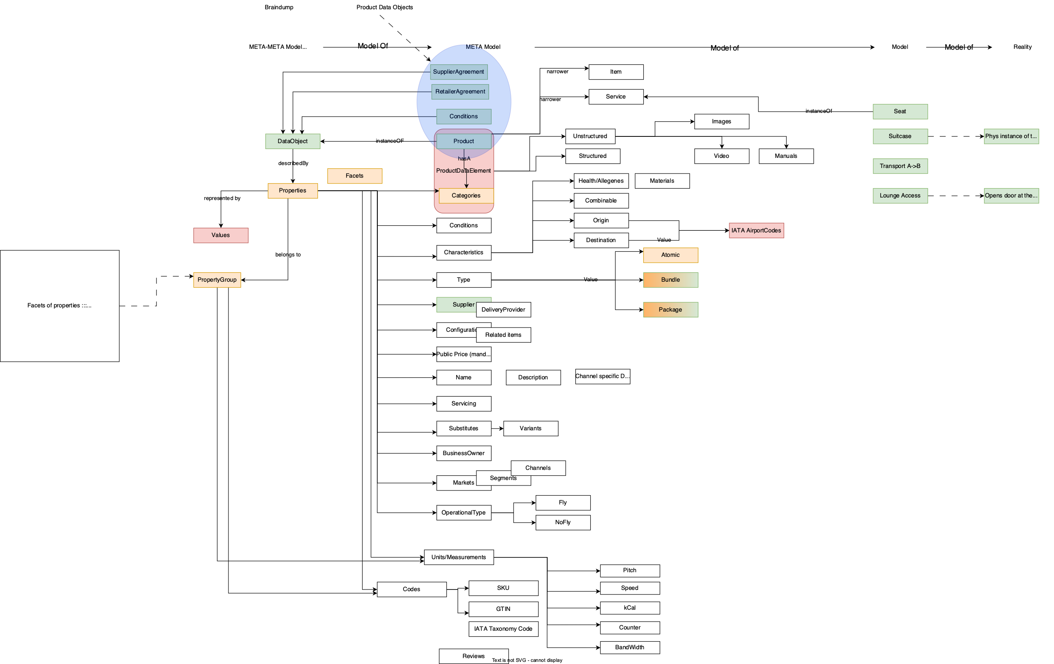
PRODUCT Model
Very very very early ideas

Slide 16
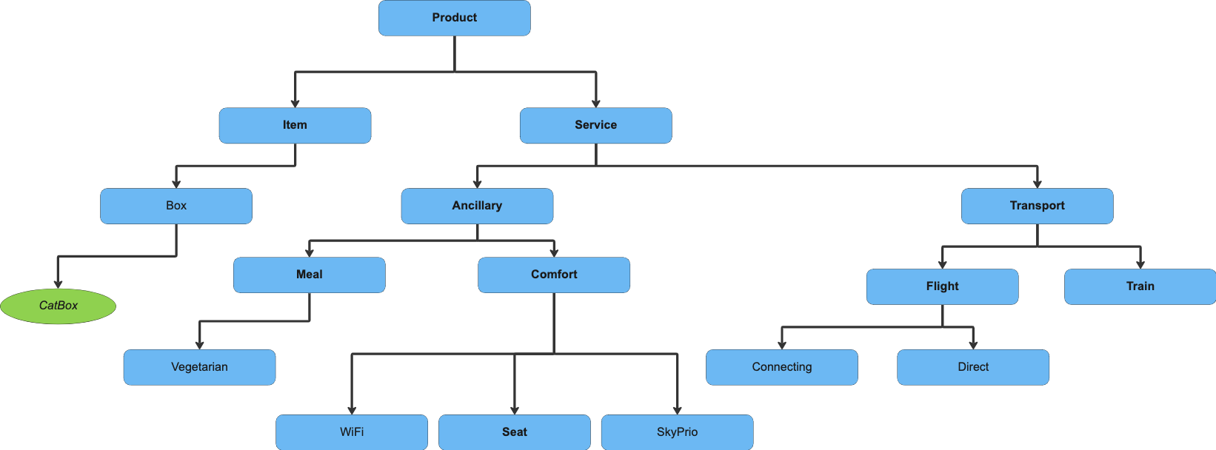
Product Information
For illustration purposes only for now
Hierarchical taxonomy instatiated from the Product Meta Model
IATA Product definition;
Root of the taxonomy
Notes:
Sell Not Flights but seat assignments ( right to fly )

